Slide 1


Telecom Customer Insights: Unveiling Usage Patterns and Churn Drivers
This presentation delves into an analysis of telecom customer data, revealing key insights into usage patterns, churn drivers, and opportunities for targeted marketing and retention strategies.
by Kunja Rahul Deep

Slide 2
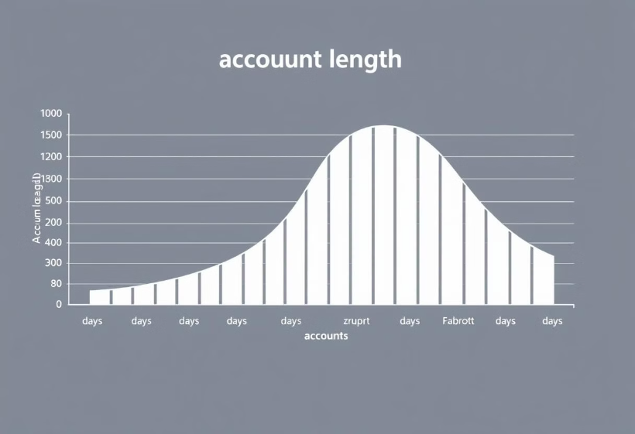
Account Length: Understanding Customer Longevity
Average Account Length
The average account length is ~100 days, with a wide standard deviation (~40 days).
Some accounts are very short-lived (minimum = 1 day), suggesting early dropoffs or recent sign-ups. Accounts with lengths exceeding 200 days (max = 243) may indicate loyal customers.

Slide 3
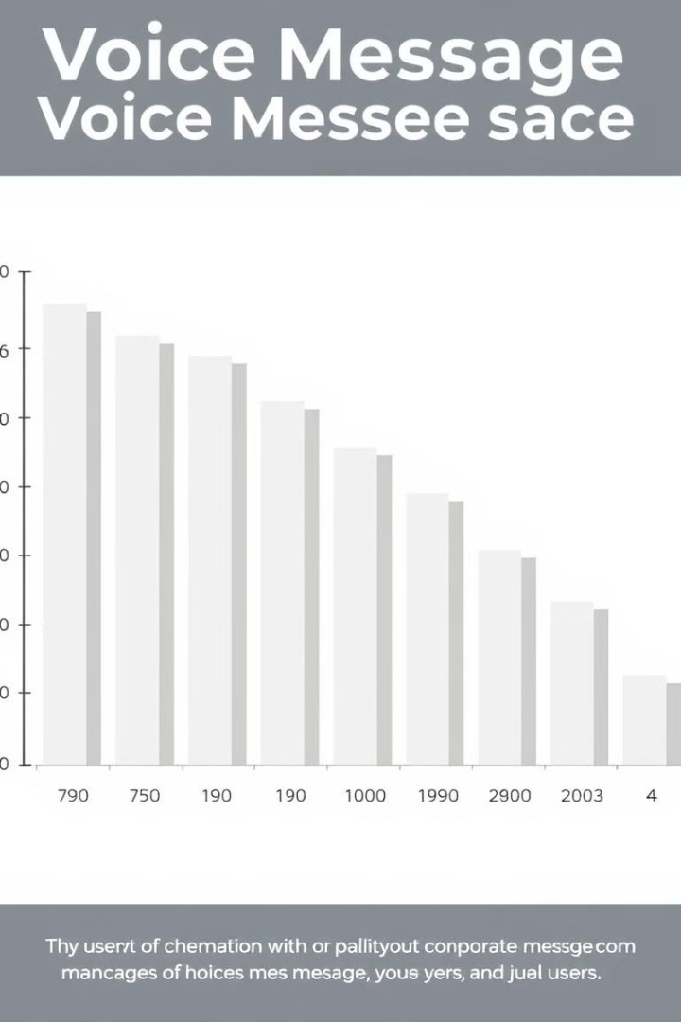
Voice Messages: Assessing Usage Habits
1
Limited Usage
2
Heavy Users Exist
50% of users (median) did not use the voice message service (voice.messages = 0).
However, the mean is ~7.75 messages, indicating a skewed distribution with some heavy users (max = 52).
3
Sparing Usage
The interquartile range (0 to 17) reveals that the majority of users use voice messages sparingly.

Slide 4
International Usage: Exploring Global Connectivity
Moderate International Usage
Affordable Rates
On average, customers use 10.26 minutes for international calls, with ~4 calls per customer.
Charges are low (~2.77), suggesting affordable international rates.
Outliers exist with a maximum of 20 calls and 20 minutes, indicating potential high-value international users.

Slide 5
Daytime Call Usage: The Peak of Activity
Dominant Usage
Varied Habits
Daytime call minutes (mean = 180.29) and charges (mean = 30.65) dominate usage patterns, showing it as the primary time of activity.
High variability (std = 53.89 mins) suggests distinct usage habits among customers.
Some users have no daytime calls (min = 0), possibly using other services or time slots.

Slide 6
Evening Call Trends: Shifting Preferences
Increased Usage
Evening Activity
Evening call minutes (mean = 200.58) are slightly higher than daytime calls, despite similar charges (mean = 17.05).
Outliers include users with nearly double the average minutes (max = 363.7), showing some preference for evening activity.

Slide 7
Nighttime Usage: Leveraging Cost-Effective Rates
Comparable to Evening
Cost-Conscious Users
Nighttime call minutes (mean = 200.39) are comparable to evening usage, but the charge (mean = 9.02) is significantly lower.
The data indicates cheaper nighttime rates, making it an attractive option for users.
Outliers show heavy nighttime activity, possibly driven by cost-conscious users or specific needs.

Slide 8
Customer Service Calls: Understanding Support Needs
Limited Support
High Dependency
Most users make 1 or fewer customer service calls (median = 1, mean = 1.57).
A few users are highly dependent on customer service (max = 9), potentially signaling dissatisfaction or technical issues.

Slide 9
Total Charges: Reflecting Diverse Usage
Wide Range
Diverse User Base
Total charges range from 22.93 to 96.15, with a mean of ~59.50.
This wide range suggests a diverse user base, from low-usage budget users to high-usage premium users.

Slide 10



Key Takeaways and Next Steps
Understanding Customer Behavior
1
Identifying Churn Drivers
2
Customer service calls and total charges show a moderate correlation with churn.
Targeted Marketing & Retention
3
Develop personalized plans for high-usage customers and address customer service issues proactively.

